Slide 1
This is a hidden slide
Dear honorable teacher please follow the instructions that has given in the slide notes (under the every slide). It would be helpful to take a successful class. Thanks a lot. I wish you good luck.

Slide 2
GOOD MORNING STUDENT
HOW ARE YOU ?
Notes:
Teacher can greet any other process

Slide 3
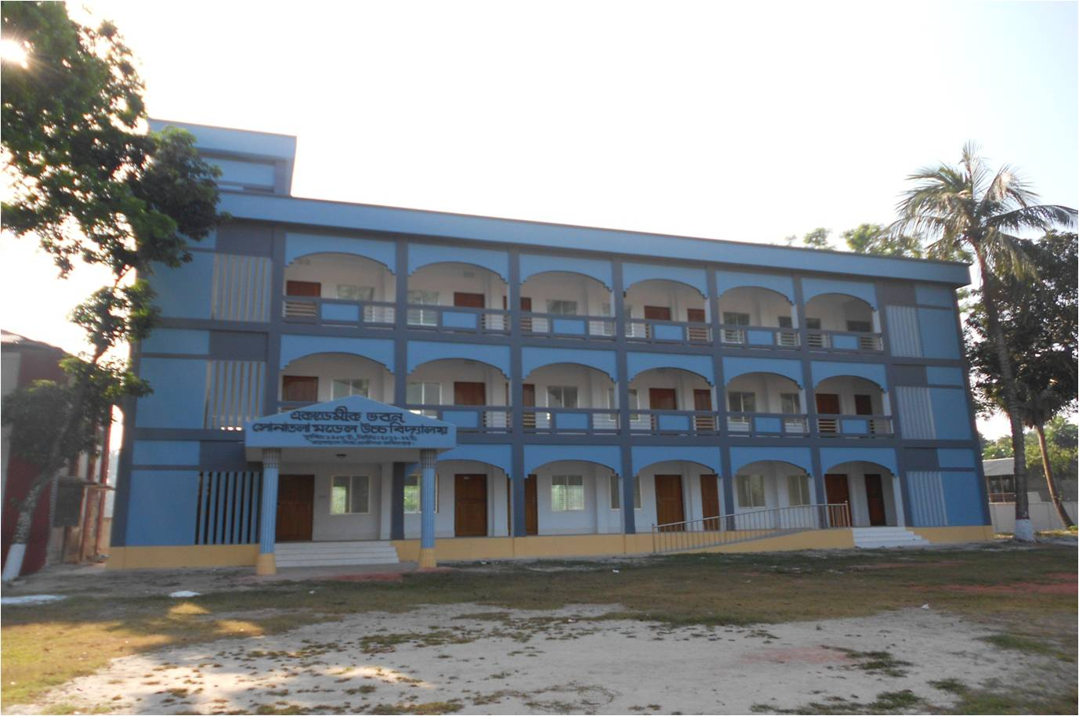
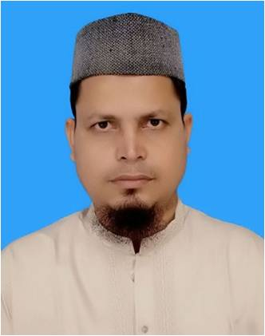
IDENTITY
SK.MD. HARUNAR RASHID.
Senior Teacher
Sonatola Model High School
Sonatola, Bogra.
ENGLISH GRAMMAR
CLASS : 6 – 8.
Notes:
Teacher can hide this slide

Slide 4
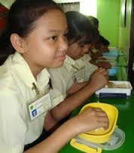
Look at the pictures
I have written a letter.
He has gone to School.
I have eaten rice.
Notes:
At first pictures will be shown. Teacher can try to elicit the answer from the students. Then he/she can give feedback by clicking.

Slide 5
TENSE
LESSON DICLARATION
PRESENT Perfect TENSE

Slide 6
LEARNING OUTCONES
After completing this lesson students will be able to –
say what is Present Perfect Tense.
write the structure of Present Perfect Tense
make correct sentence according to Present Perfect Tense.
re-write in Present Perfect Tense.

Slide 7
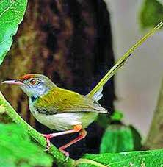
Present Perfect Tense
Present Perfect Tense is used when the work has been done but its effect lasts.
কোন কাজ শেষ হয়েছে অথচ তার ফল বর্তমান আছে বোঝালে Present Perfect Tense হয়।
চিনিবার উপায়ঃ-
বাংলায় ক্রিয়ার শেষে য়াছি, য়াছ, য়াছেন চিহ্ন থাকিবে।
যেমনঃ সে স্কুলে গিয়াছে।
আমি একটি পাখি দেখিয়াছি।
আমরা কাজটি করিয়াছি।
Notes:
Teacher can try to elicit the answer from the students. Then he/she can give feedback by clicking.

Slide 8
Present Perfect Tense
গঠন প্রণালী
Aff : Sub + have/has +V3 + obj.
Neg : Sub + have not/ has not + V3 + obj.
Intre : Have/ Has + Sub + V3 + obj ?
Subject বা কর্তা যদি 3rd person singular number হলে has অন্য ক্ষেত্রে have বসে।
Notes:
At first pictures will be shown. Teacher can try to elicit the answer from the students. Then he/she can give feedback by clicking.

Slide 9
Use of have/has
Person | Singular | Plural
1st | I have | we have
2nd | You have | You have
3rd | He/She has | They have
Notes:
At first pictures will be shown. Teacher can try to elicit the answer from the students. Then he/she can give feedback by clicking.

Slide 10
Affirmative Sentence.
Person | Singular | Plural
1st | I have eaten rice. | We have eaten rice.
2nd | You have eaten rice. | You have eaten rice.
3rd | He/She has eaten rice. | They have eaten rice.
Notes:
At first pictures will be shown. Teacher can try to elicit the answer from the students. Then he/she can give feedback by clicking.

Slide 11
Negative Sentence
Person | Singular | Plural
1st | I have not eaten rice. | We have not eaten rice.
2nd | You have not eaten rice. | You have not eaten rice.
3rd | He/She has not eaten rice. | They have not eaten rice.
Notes:
At first pictures will be shown. Teacher can try to elicit the answer from the students. Then he/she can give feedback by clicking.

Slide 12
Interrogative Sentence
Person | Singular | Plural
1st | Have I eaten rice ? | Have we eaten rice ?
2nd | Have you eaten rice ? | Have you eaten rice ?
3rd | Has he/she eaten rice ? | Have they eaten rice ?
Notes:
At first pictures will be shown. Teacher can try to elicit the answer from the students. Then he/she can give feedback by clicking.

Slide 13
INDEVETUAL WORK
Fill in the gaps with the right form of verbs (according to Present Perfect Tense) that given in the box.
Play | Make | Have/has
Catch | Do | go
We (a) -------------- a box. He has (b) ------------- a bird.
Have you (c) ---------------- the work ? They (d) --------------
not gone to school. Saad has not (e) ------------- football.
made
caught
done
have
played
Notes:
At first pictures will be shown. Teacher can try to elicit the answer from the students. Then he/she can give feedback by clicking.

Slide 14
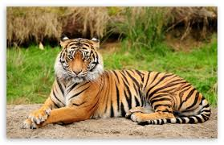
Pair Works
Write three sentences (affirmative, negative and Interrogative) about the above picture according to the rules of Present Perfect Tense.
Notes:
At first pictures will be shown. Teacher can try to elicit the answer from the students. Then he/she can give feedback by clicking.

Slide 15
GROUP WORKS
Read the passage and rewrite it in the Present Perfect Tense.
Sayeed is reading English. He likes English very much . He is thinking. He went to school. He is writing a paragraph.
Notes:
At first pictures will be shown. Teacher can try to elicit the answer from the students. Then he/she can give feedback by clicking.

Slide 16
HOME WORK
Write down five sentences that you and your sister do at your house.
Notes:
Teacher can give some instructions to do the home task.

Slide 17
Acknowledgement
We would like to express our cordial gratitude to the Ministry of Education, Directorate of Secondary & Higher Education, NCTB, a2i
and
the panel of honorable editors ( Md. Jahangir Hasan, Associate Professor (English) TTC, Rangpur, Ranjit Poddar, Associate Professor (English) TTC, Dhaka, and Urmila Ahmed, Associate Professor (English) TTC, Dhaka, to enrich the contents.

Slide 18
THE END.
Notes:
Teacher can use another language

